Slide 1
Data-Driven Approaches to Education and Workforce Alignment
Robert McGough – Chief Data Officer
Kristen Shryock – Chief Skills Strategy Officer
Department of Transformation and Shared Services (TSS)
Arkansas Data Office (ARData)

Slide 2
Agenda
Statewide Longitudinal Data System (SLDS)
Arkansas Credential Registry
Arkansas LAUNCH – Skills-Based Learning, Hiring, and Advancement
Q&A

Slide 3
Statewide Longitudinal Data System

Slide 4
What other data would be relevant?

Slide 5
Multistate and Cross-Sector Coverage
Working towards more timely and complete signaling of demand from employers through several efforts with the U.S. Chamber of Commerce Foundation.
Working towards multistate coverage of employment and earnings.
Working towards coverage of non-UI occupations through the IRS Secure Query Service (SQS).
Working to reduce the impact of record linkage bias (particularly for foreign-born students) through R&D for the National Science Foundation.
Working with federal agencies on increased sharing of military learning and employment data.
Arkansas has joined the Longitudinal Employer Household Dynamics (LEHD) program with the U.S. Census Bureau.

Slide 6
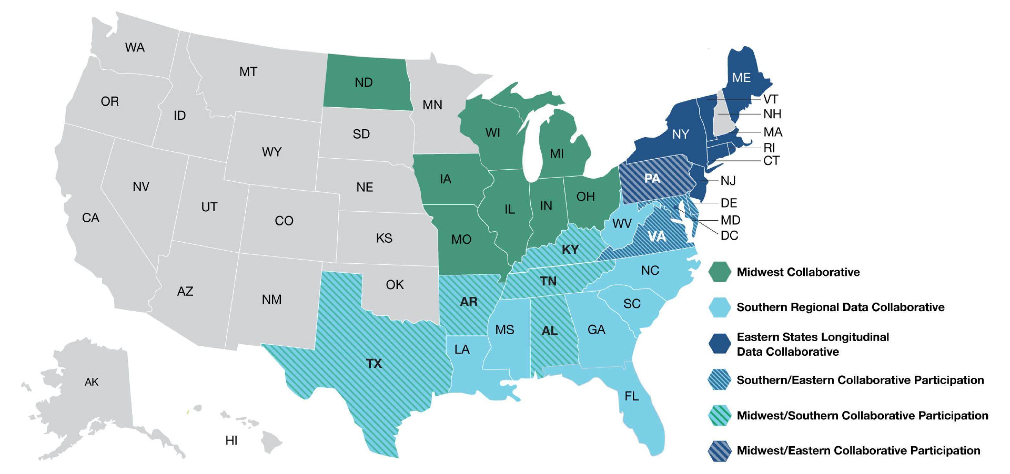
Arkansas Research Environment
The Arkansas Research Environment is a cloud-based data enclave for facilitating secure, compliant, and efficient access to linked longitudinal data.
It is supported by the Administrative Data Research Facility (ADRF), which is used by many federal agencies and a growing number of states.
It also supports sharing of products and methodologies and collaborative research and development.
The ADRF is governed by the Multi-State Data Collaboratives.

Slide 7
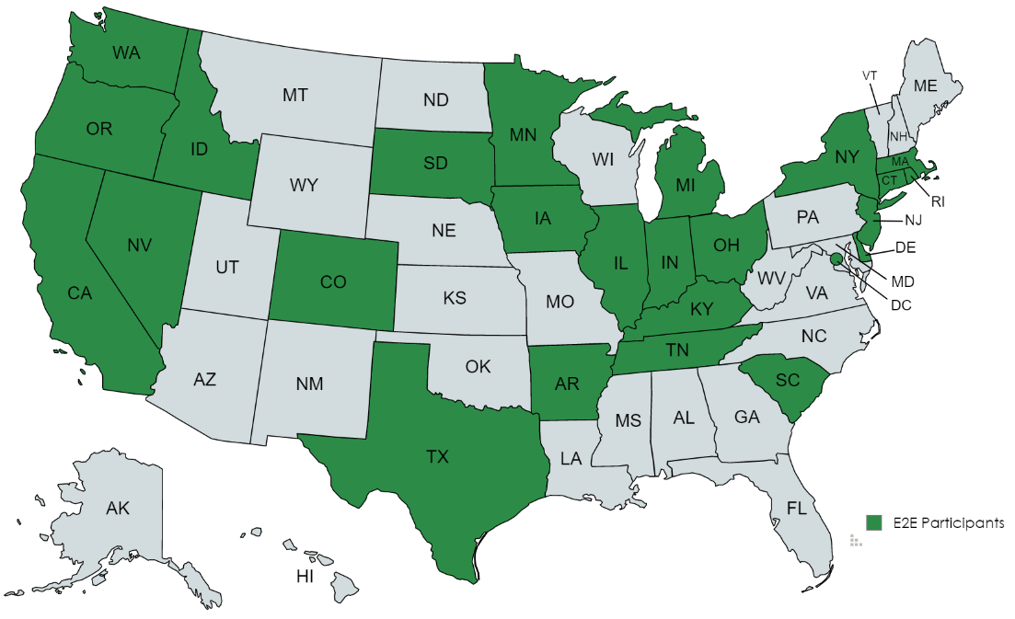
Applied Data Analytics Training Programs
To build analytic capacity and a trained community of practice, Applied Data Analytics (ADA) training programs are available to build data literacy, data science, and evaluation and research skills.
Interdepartmental, multistate, and cross-sector teams work together to serve real needs.
The current AR-developed program “Evaluating Enrollment to Employment Pathways” (E2E) has participants from 25 states resulting in numerous projects and products for Arkansas.
Project Title | State(s) | Program(s)
Stayers, Stutterers, and Leavers, Oh My! - Analyzing Arkansas SNAP Spells | AR | SNAP
Effectiveness of Adult Educational Programs on Workforce Outcomes | AR | Adult Ed
Your Arkansas Pathway | CT, AR | WIOA, Adult Ed, Postsecondary
Factors Influencing Apprenticeship Completion in Arkansas | CT | RAPS
Role of Demographics on Apprenticeship Completion Status | DC | RAPS
Enrollment in Quality Jobs Post-WIOA Participation | DE, MA | WIOA
Co-Enrollment: Retention and Wages Over Time | MO | WIOA
Employment Outcomes of SNAP Recipients in 2017 | NJ | SNAP
Better Together? SNAP and WIOA | OH | SNAP, WIOA

Slide 8
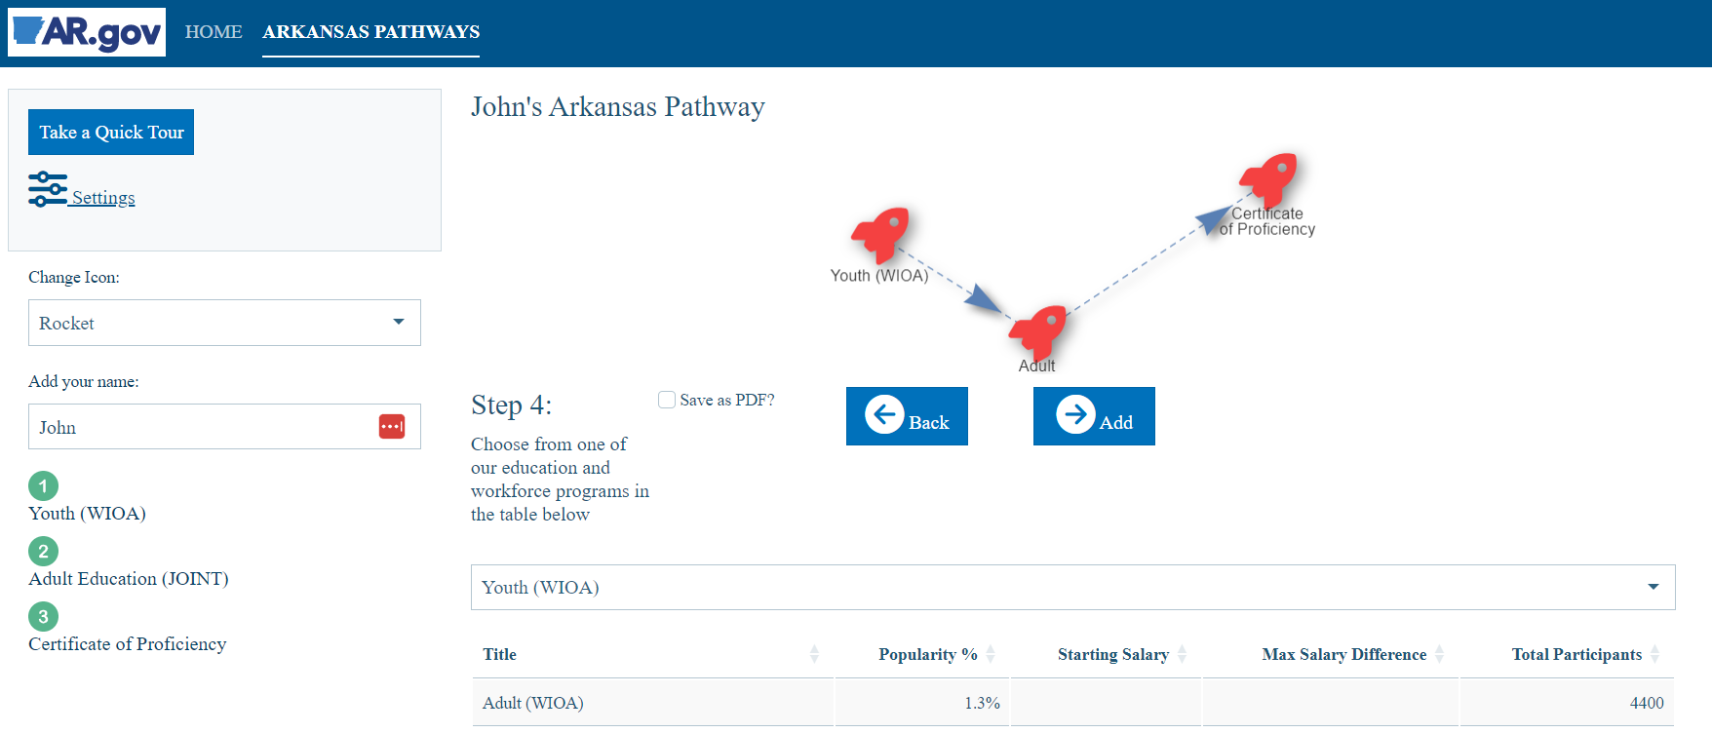
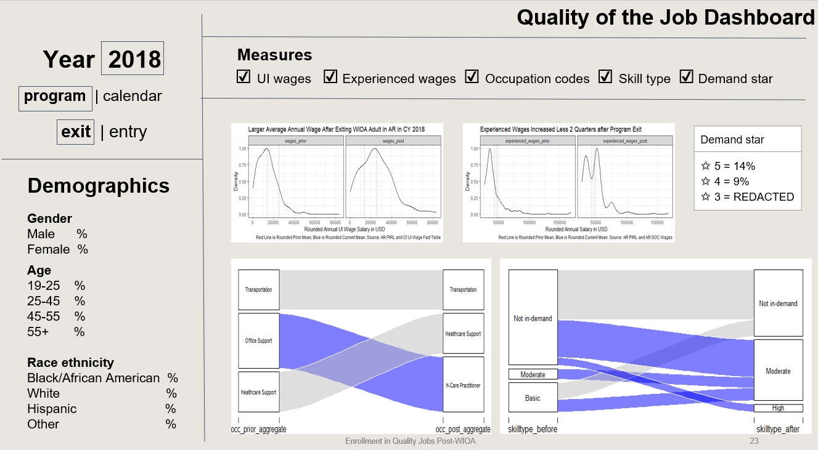
Sample Products Developed by Applied Data Analytics Program Students

Slide 9
Participating IHE Researchers
Office of Innovation for Education (OIE)
Office for Education Policy (OEP)
Arkansas Research Center (ARC)
Arkansas Economic Development Institute (AEDI) – Enrolled in May 2024 program
What research groups at your institutions may benefit from access?

Slide 10
ARKANSAS
CREDENTIAL REGISTRY

Slide 11
TEAM
Support the secure and compliant sharing, integration, and use of data and information across departments, states, and sectors.
Kristen Shryock, Chief Skills Strategy Officer
Lead the Skills-Based Initiatives Team, focusing on the data and systems to support skills-based learning, hiring, and advancement statewide.

Slide 12
THE CREDENTIAL LANDSCAPE
1.076M
59,000+
Credentials in the U.S.
Credential providers

Slide 13
THE CHALLENGE: LARGE AND COMPLEX
WHAT PROGRAMS ARE OFFERED?
WHICH PROGRAM IS THE RIGHT FIT?
WHAT ARE THE PROGRAM RESULTS?
Data is siloed and disconnected. Information is online, but is often in many places and conflicting or incomplete. Data from institutions, state data, and national data.
Students: Cost, Location, Delivery, Transferability of Prior Learning
Educators: What program will prepare students for desired career path?
Employers: What is the right fit for my talent needs and gaps?
How many people are employed?
Is this a Credential of Value?
What programs should be offered?
What’s in high demand?
Notes:
Offered - data is siloed, in many places, and sometimes conflicting
Fit -
1. Students: cost, location, delivery type, transferability of prior learning.
2. Economic Dev/ Businesses: what is the right fit for my talent gaps
3. Educators: What program will prepare students for desired career path?
Results -
1. Workforce - How many people are employed? Is this a Credential of Value?
2. Social Determinants of Health
3. Educators - what programs to continue offering, what's missing? what's in high demand?

Slide 14
THE SOLUTION: CREDENTIAL TRANSPARENCY
Hosts detailed information about credentials and skills and makes it accessible to anyone from anywhere. Allows providers to upload information and fuels the development of tools and services that use this information to help people make better decisions.
CREDENTIAL REGISTRY
A non-profit whose mission is to map the credential landscape with clear and consistent information, fueling the creating of resources that empower people to find the pathways that are best for them.

Slide 16
CREDENTIAL TRANSPARENCY
DESCRIPTION LANGUAGE
LINKED, OPEN DATA ON CREDENTIALS
HUMAN READABLE
Credential Finder tool allows individuals, credential providers, government agencies, and others to search all of the data in the registry.
The only common language that describes key features of credentials, credentialing organizations, competency frameworks, and quality assurance bodies. It is the dictionary for describing credentials and includes 900+ terms and the grammer for using those terms.
MACHINE READABLE
Statewide skills-based learning, hiring, and advancement platform can provide career, program, and job recommendations based on data in the registry linked to actual Arkansas data.

Slide 17
What Data is in the Registry?
Organizations
Support Services
Organization Type
Location(s),including all addresses and satellite campuses.
Academic or Career Guidance
Physical features or modifications of facilities
Adaptative technologies or offerings
Provision of housing, clothing, or learning resources
Credentials Offered
Financial Assistance
Degrees
Licenses
Certifications
Stackable Credentials
Badges
Micro-credentials
Financial assistance available to assist in the pursuit or completion of a credential
Learning Opportunities
Transfer Value
Programs
Courses
Related information, including time to complete
How value can be transferred from one form of learning in another context, typically credit transfer values
Competencies
Outcomes Data
Learning Objectives
Skills
What is learned or gained from the Learning Opportunity or upon earning the credential
Number of credential awardees
Number of awardees employed
Related earnings over one or more time periods
Assessments
Jobs, Occupations, and Pathways
Assessments required for a Credential or Learning Opportunity
Occupations and Jobs can link to Competencies or Credentials, or be combined with other data to create Pathways

Slide 18
USING REGISTRY DATA
LAUNCH: SKILLS BASED LEARNING, HIRING, AND ADVANCEMENT PLATFORM
LEARNING AND EMPLOYMENT RECORDS
CONSUMER
TOOLS

Slide 19
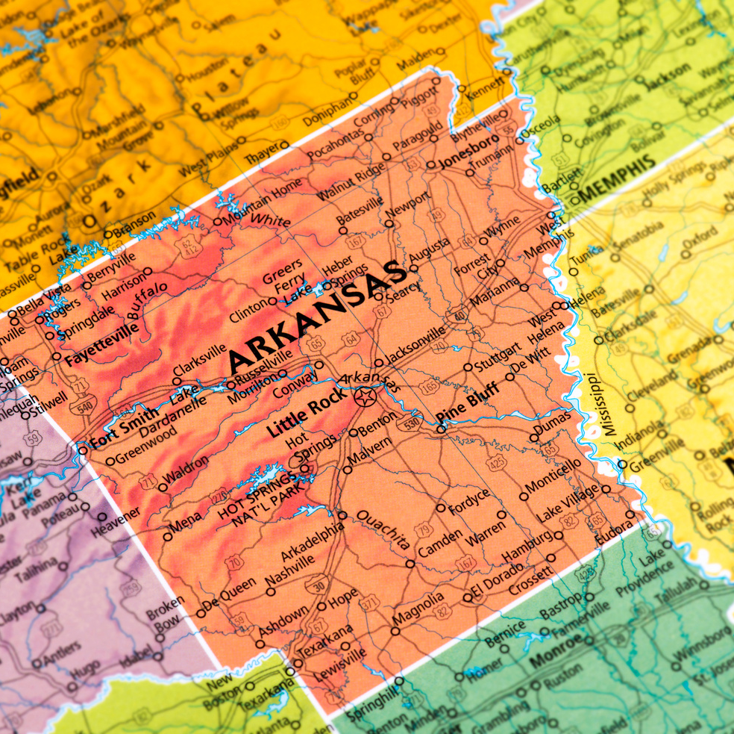
CONSUMER INFO PRODUCTS
LET’S MARKET YOUR PROGRAMS!
Notes:
1. Locations
2. Cost/Financial Assistance
3. Delivery Method - in person, online, blended
4. what skills will someone learn?
Students are asking, workforce development professionals are asking, parents are asking

Slide 20
WORK IS UNDERWAY!
CORRECTIONAL SCHOOL DISTRICT
DIVISION OF HIGHER EDUCATION
DIVISION OF CAREER AND TECHNICAL EDUCATION
GOODWILL INDUSTRIES

Slide 21
ARKANSAS CREDENTIAL REGISTRY
TRACKER
Credentials
Learning Opportunities
Competencies
22
368
601

Slide 22
EMAIL ADDRESS
GET IN TOUCH WITH US
KRISTEN.SHRYOCK@ARKANSAS.GOV
PHONE NUMBER
501-682-4130
LINKEDIN
LINKEDIN.COM/IN/KRISTENMSHRYOCK
FOR INQUIRIES OR FOLLOW-UPS

Slide 23
LAUNCH – Skills-Based Learning, Hiring, and Advancement Platform

Slide 26
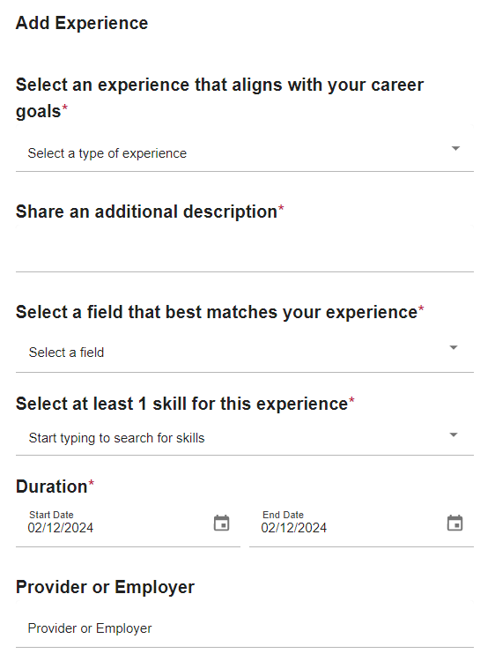
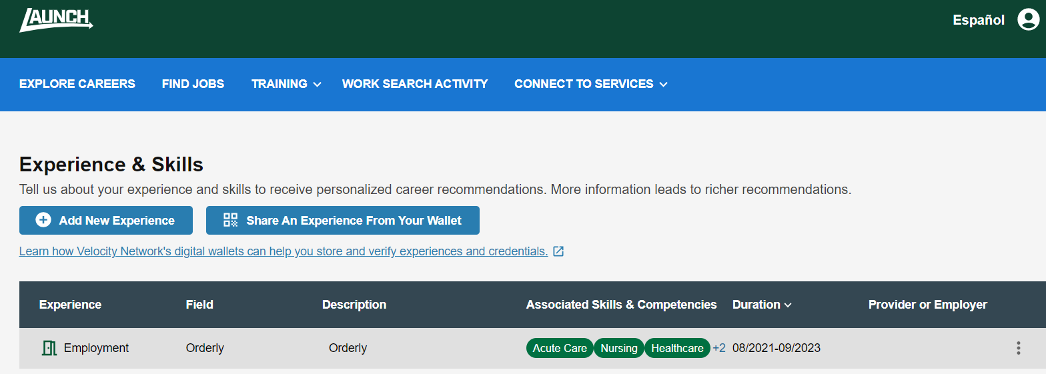
Users can add education, skills, and experience manually, parse them from a resume, or import them from Learning and Employment Records (LERs)
The credential registry can identify skills and competencies associated with a credential, learning opportunity, or experience

Slide 27
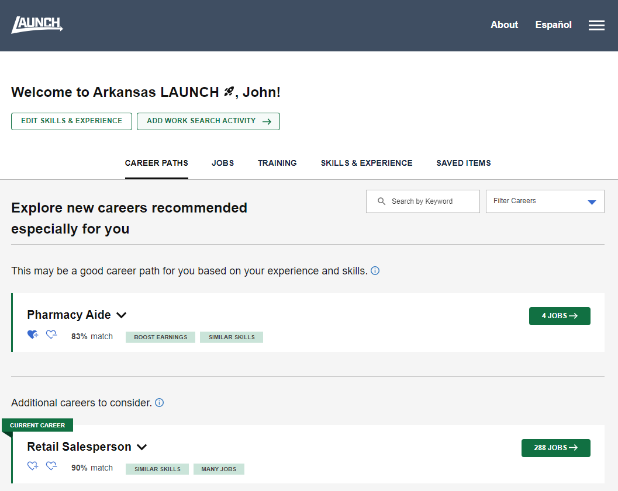
Explore career recommendations based on skills matching, user preferences, and successful real world job transitions from over a decade of actual Arkansas data
User can save likes/dislikes
Exploration in current or new career
Filtering by earnings boost, similar skills, many jobs

Slide 28
Learn about career paths including common skills and training
See related jobs
See short videos
Additional state data (wages, demand) can be added
Additional Arkansas-specific videos and content coming soon from Edge Factor (filming now)

Slide 29
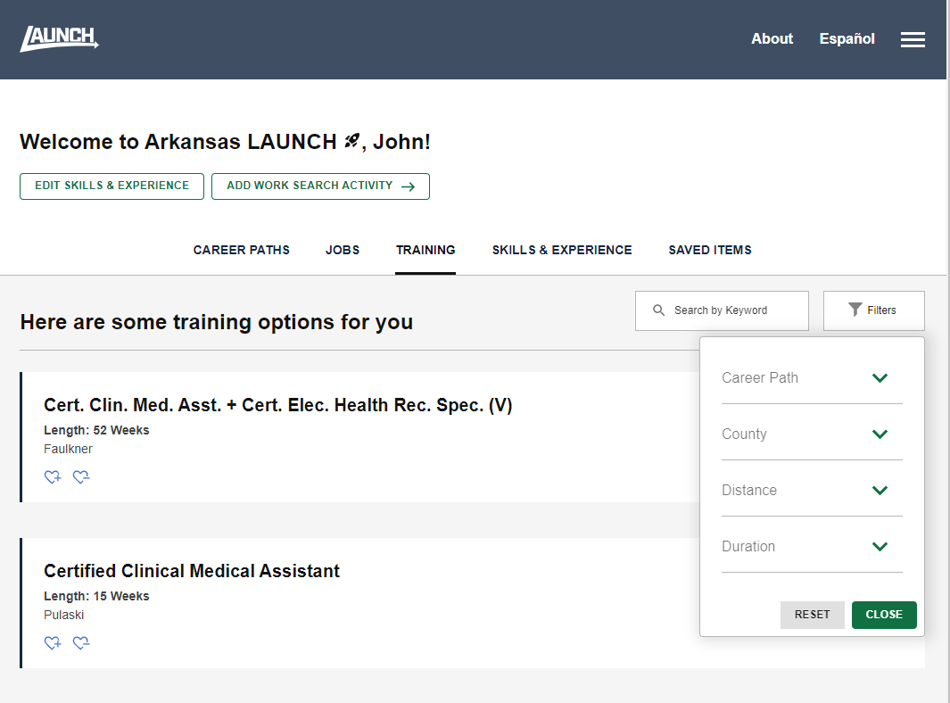
Explore training recommendations
Additional programs being added through the Arkansas credential registry
Filtering by career path, location, duration

Slide 30
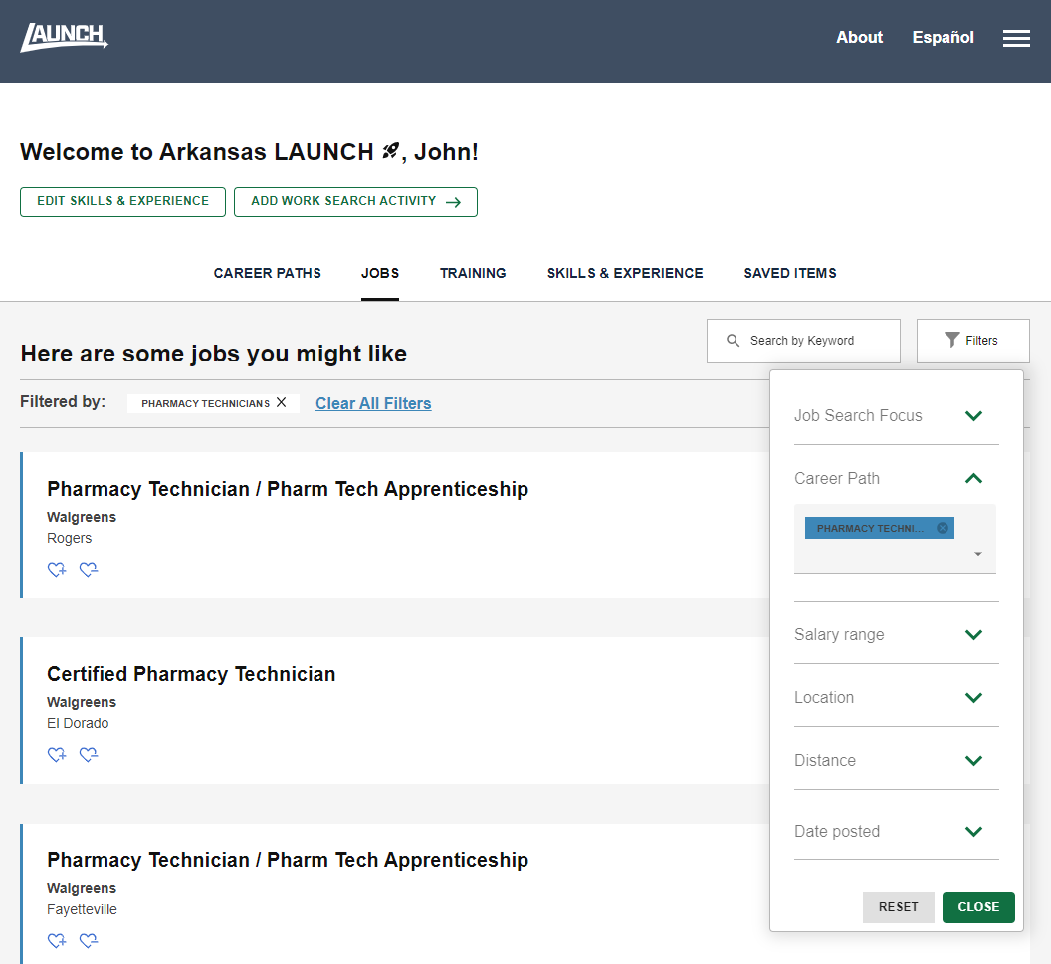
Explore job recommendations
Filtering by job search focus, career path, salary range, location, posting date
All job postings available from the National Labor Exchange (NLX)
The NLX Research Hub is also available to analyze current and changing occupation & skills demand, posting duration, etc.

Slide 31
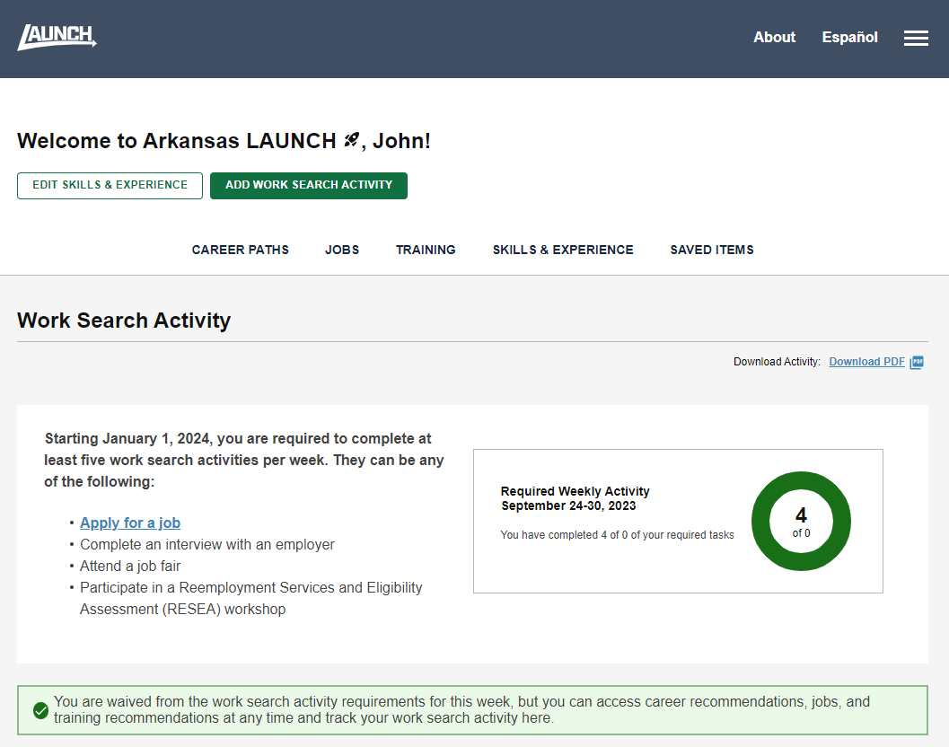
See work search activity requirements and current status
Download PDF report of work search activity
Automatically submitted to state systems

Slide 32
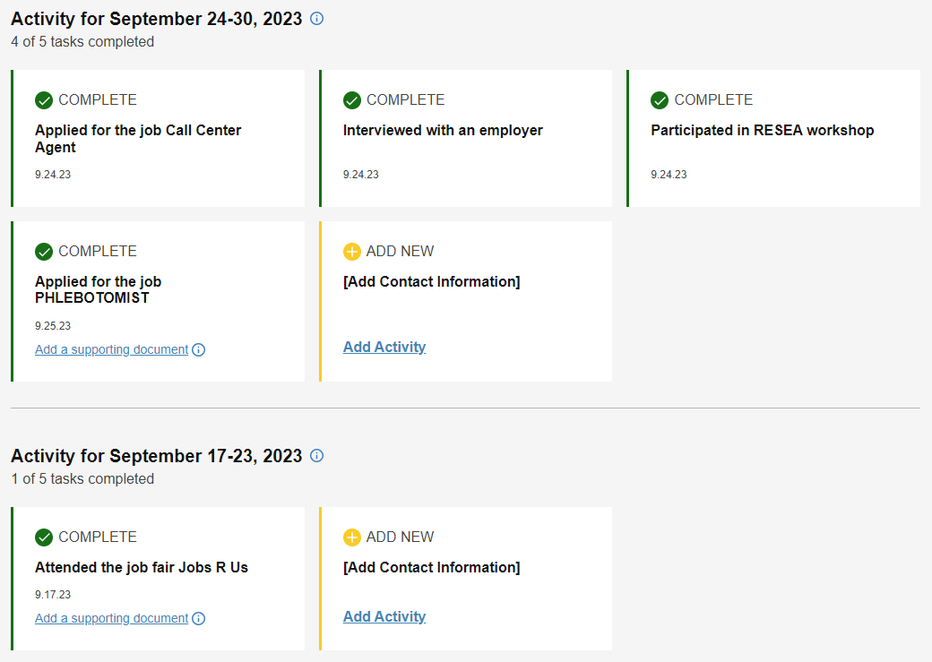
Easy, interactive work search and interaction reporting
In-system work search activity prepopulated
Add supporting documentation

Slide 33
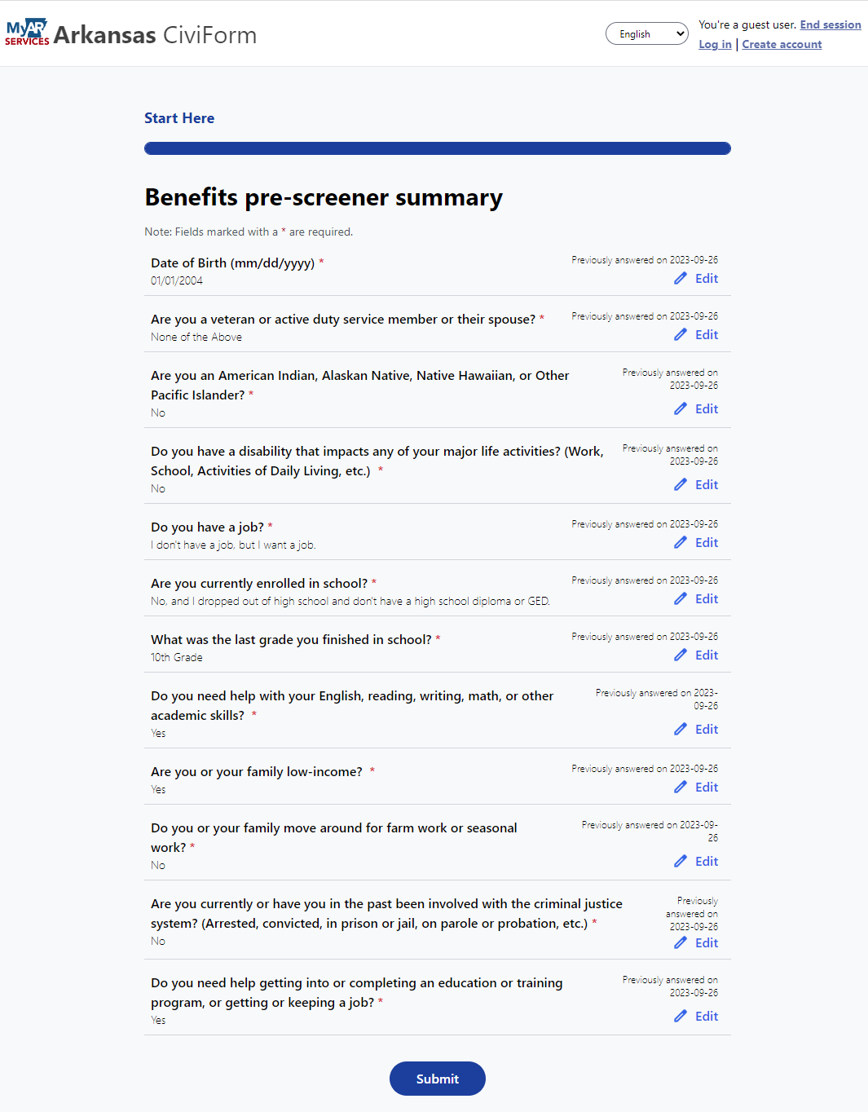
Connection with Supportive Services
Service discovery and common intake portal allows for easy discovery of and connection to state, federal, and community-based programs and services.
Users can receive nudges when new potentially relevant programs are added.
A trusted intermediary role allows for assistance from counselors, coaches, navigators, etc.
Intakes can be sent electronically to case management systems or managed in the portal.
What programs, services, and intermediaries would be most beneficial for your students?

Slide 34
Questions
Robert.McGough@Arkansas.Gov
Kristen.Shryock@Arkansas.Gov

